Slide 1


Preparation of TIF 2012 – Overview, dd. 08.06.2011
IDEA Project
Transport dialogue and interoperability between the EU and its neighbouring countries and Central Asian countries
Project funded by European Union
Detlef Pulsack
IDEA Prioritization Wrap Up Meeting
Milan, 8th June 2011

Slide 2
Communication
EYE CATCHERS
TOPICS
COMMUNICATION
SALE

Slide 3
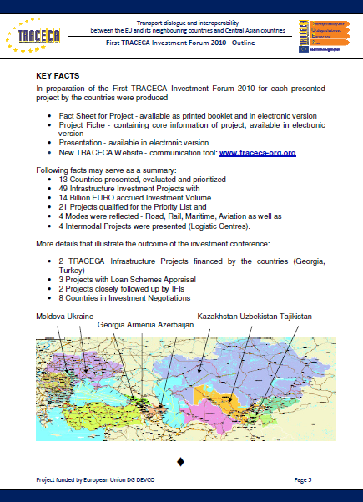
Results TIF 2010
12 Countries presented, evaluated and prioritized - 49 Infrastructure Investment Projects with - 14 Billion EURO accrued Investment Volume
21 Projects qualified for the Priority List - 4 Modes were reflected - Road, Rail, Maritime, Aviation as well as - 4 Intermodal Projects were presented (Logistic Centres).
2 TRACECA Infrastructure Projects financed by the countries (Georgia, Turkey)
3 Projects with Loan Schemes Appraisal
2 Projects closely followed up by IFIs and 8 Countries in Investment Negotiations

Slide 4
From 21 to 12
Presented projects in 2010: 21
New approach for 2012: 12
Country information in regional contexts
Regions: 3 Project: 1
Countries: 4
+ Individual Promotion for countries through website and print media possible,
BUT
on minimum requirement basis
Milan, 8° June 2011
IDEA Prioritization Wrap Up Meeting
4
Notes:
4

Slide 5
Road Map
Preparation of Priority List and underlying
documentation
presentations – NS (training)
fact sheets + fiches
studies
      Country information – Update by National Secretariats
      Methodologies
        Prioritzation
        TRAX
        TRACECA TOOL BOX
        TRAINING CYCLES enhance
        TOOLS

Slide 6
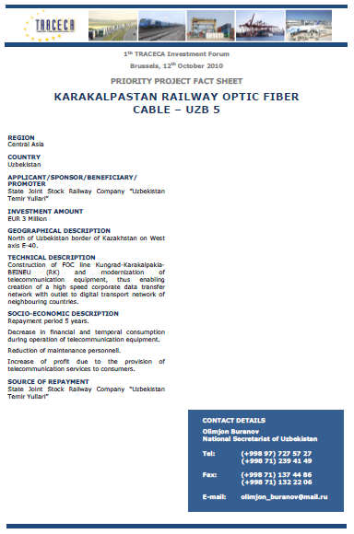
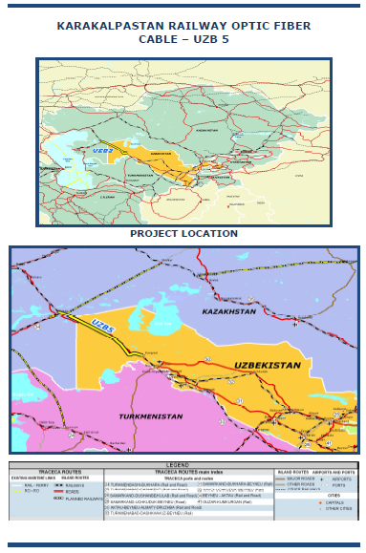
Fact Sheet – Sample 2011 (TOOL)

Slide 7
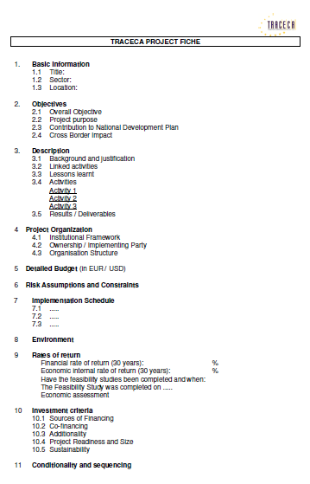
Fiche – Outline (TOOL)
Basic Information
Objectives
Description
Organization
Budget
Risk Assumptions
Implementation
Schedule
Environment
Rates of Return
Investment Criteria
Sequencing

Slide 8
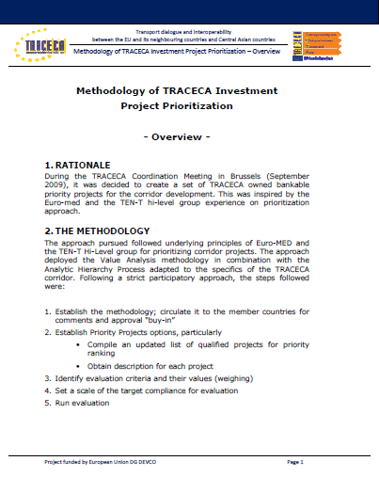
Prioritization Methodology (TOOL)

Slide 9

TRAX Methodology (TOOL)

Slide 10
Road Map – Basic and NEW components
Communication with FIs + Invitations
Invitations to additional regional players
China, Korea, India, Russia
Attraction of transport industry

Slide 11

Communication Tool

Slide 12
Operator‘s DATABASE
Armenia | India | Moldova
Azerbaijan | Indonesia | Netherlands
Belorussia | Italy | Romania
Bulgaria | Japan | Russia
China PRC | Kazakhstan | Tajikistan | TRACECA
Cyprus | Korea South | Turkey | Observers
France | Kyrgyzstan | Turkmenistan | BIG PLAYER
Georgia | Liberia | Ukraine | IMPORTANT HUB
Germany | Lithuania | UAE | IDEA
Greece | Malaysia | Uzbekistan | OTHERS

Slide 13
Road Map
Determination and solution of logistic issues
      hotel
      transport
Event Management
      sessions
      catering
Public Visibility
      ENPI
      website

Slide 14
How to implement - SUMMARY
Provision of more general information reflecting the development within TRACECA
Globalized – focussed on regional contexts
Accompanying communication (newsletters)
Logistic issues as for TIF 2010
Schedules

Slide 15
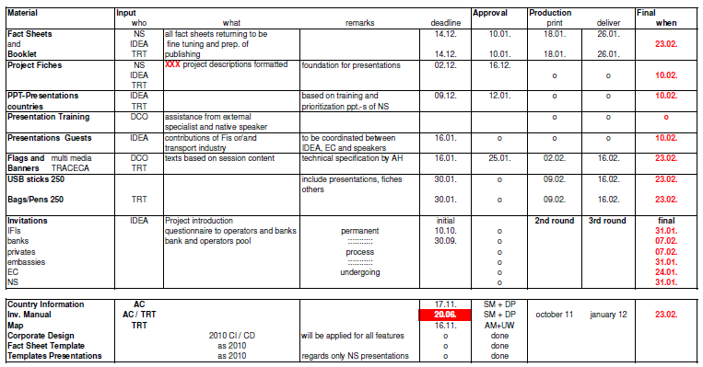
Action Plan

Slide 16

Milan, 8° June 2011
IDEA Prioritization Wrap Up Meeting

Slide 17
Near Future & Undergoing
Update of contact database – approx. 300 individual data (email addresses, telephone numbers) of international bankers
TRACECA Appraisal Tool
investment manual
case studies, training results
TIF Webpage Update – already started (first downloads available)
Emailing and visits to financial partners (see travel plan key experts)
NEW database of operators and transport associations

Slide 18
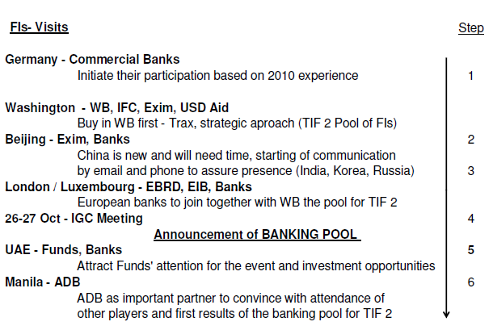
Direct Contacts – Communication Tool

Slide 19
INPUT from the NS – DEADLINES
Project information as investment volumes, context, incentives for operators and investors
TRACECA CORRIDOR
“What we have” as help – provided until summer
Deliverables by the Countries
Fact Sheets September, 15
Fiches October, 15
Country Information November, 25
3 months to TIF
IGC Meeting = Overview TRACECA activities
Milan, 8° June 2011
IDEA Prioritization Wrap Up Meeting
19
Notes:
19

Slide 20
Countries’ TO DO
1) Communication with local banks + Invitations
2) INPUT for documentation
papers
website content – country information
WEBSITE (MAIN TOOL)
3) Manpower
trainings
website management and update projects

Slide 21
Thanks for your attention.
DO NOT FORGET TO CHECK AND USE
www.traceca- org.org

