Slide 1
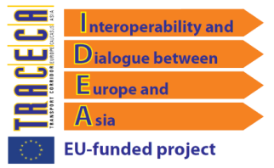
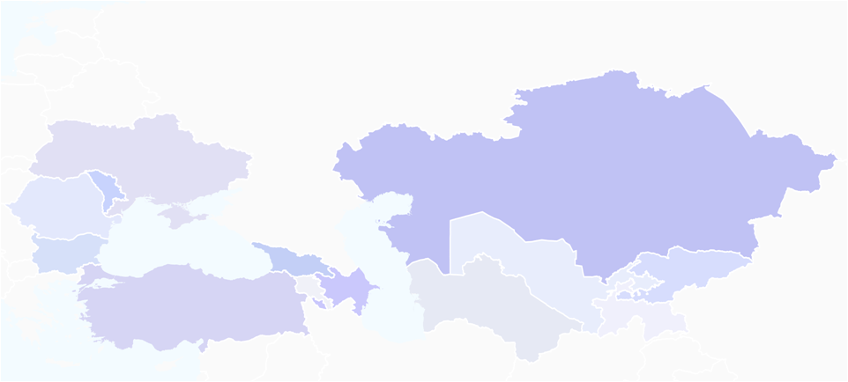
Prioritization Process II
IDEA Project
Transport dialogue and interoperability between the EU and its neighbouring countries and Central Asian countries
Project funded by European Union DG DEVCO
Silvia Maffii
TRT Trasporti e Territorio
Milan, 8-9 June 2011

Slide 2
II Prioritization process
Steps
Update of the criteria weighting
Project selection and preparation of the presentation
Three regional evaluation conferences:
Almaty - Central Asian + Moldova
Kiev - South East Europe + Tajikistan and Turkey - guests EIB, WB, EC Delegation
Tiblisi – Caucasus + Turkey + Ukraine and Uzbekistan – guests USAID, EC Delegation
Milan, 8-9 June 2011

Slide 3
Weights for criteria
Comparison with Process I
WEIGHTS 2010 – PROCESS I
Regional integration criteria | Technical criteria | Economic criteria | Environmental criteria | Policy based criteria
28.08% | 18.65% | 18.85% | 15.96% | 18.46%
WEIGHTS 2011 – PROCESS II
Regional integration criteria | Technical criteria | Economic criteria | Environmental criteria | Policy based criteria
27.50% | 18.75% | 22.92% | 15.42% | 15.42%
Milan, 8-9 June 2011

Slide 4
II Prioritization process
Approach
The TRACECA Priority List ensures that
Each country has a project in the priority list
All the modes are represented in proportion
12 projects identified
Milan, 8-9 June 2011

Slide 5
Presented projects
Central Asia – 16 Projects
 | Mode | Project name | Project code
1 | Rail | Almaty-Aktogay railway electrification | KAZ1
2 | Rail | Aktogay-Dostyk railway electrification | KAZ2
3 | Rail | Aktogay-Mojinty railway electrification | KAZ3
4 | Road | Tashkent-Shimkent road reconstruction | KAZ4
5 | Road | Osh-Batken-Isfana road reabilitation | KYR1
6 | Air | Aeronavigation | KYR2
7 | Multimodal | Involvement of Single Window System | KYR3
8 | Air | Osh airport reconstruction | KYR4
9 | Air | Issyk-Kul airport reconstruction | KYR5
10 | Rail | Kolkhozabad-Dusty-Nizhnij Pyanj railway | TAJ1
11 | Rail | Vakhdat-Dzirgatal (-Kyrgyzstan) railway | TAJ2
12 | Road | Guliston-Dusti road rehabilitation | TAJ3
13 | Road | Khorog-Kulma road rehabilitation | TAJ4
14 | Rail | Vakhdat-Yavan new railway | TAJ5
15 | Road | Ecological Control System | UZB1
16 | Road | Centralised Information Web for Customs | UZB2
Milan, 8-9 June 2011

Slide 6
Presented projects
South East Europe – 10 Projects
 | Mode | Project name | Project code
1 | Maritime | Varna Ferryboat | BUL1
2 | Intermodal | Ruse Terminal Construction | BUL2
3 | Road | Unguri-Brosnitsa border crossing | MLD1
4 | Intermodal | Prut river multimodal link | MLD2
5 | Road | Slobozia Bypass on Chisinau-Giurgiulesti road | MLD3
6 | Air | Balti Airport Construction | MLD4
7 | Road | Mures-Iasi-Ungheni motorway section | ROM1
8 | Road | Constanta-Vama Veche Motorway | ROM2
9 | Maritime | Yuzhny Port Infrastructure Development | UKR1
10 | Intermodal | Ilyichevsk Port | UKR2
Milan, 8-9 June 2011

Slide 7
Presented projects
Caucasus + Turkey – 13 Projects
 | Mode | Project name | Project code
1 | Intermodal | Yerevan Logistic center | ARM1
2 | Road | Rehabilitation of key highway connections | ARM2
3 | Rail | Baku Alyat Beguk Kesir railway rehabilitation | AZR1
4 | Intermodal | Western NIS and Caucasus International Logistic Center | GEO1
5 | Intermodal | Black Sea Optic Fiber Cable | GEO2
6 | Rail | Georgian railway level crossing automation | GEO3
7 | Rail | Poti Baku container block train | GEO4
8 | Maritime | Ilyichevsk Samsun shipping line | GEO5
9 | Maritime | Varna Ilyichevsk Poti shipping line | GEO6
10 | Road | Rikoti Zestaponi Highway | GEO7
11 | Road | Zestaponi-kutasi Samatredia Highway | GEO8
12 | Road | Gerede Gurbulak road border gate improvement | TUR1
13 | Air | Istanbul Airport Passengers Rights Information Center | TUR2
Milan, 8-9 June 2011

Slide 8
Projects per transport mode
Summary of projects per transport mode
Region | Air | Rail | Road | Maritime | Intermodal
Central Asia | 3 | 6 | 6 | 0 | 1
South East Europe | 1 | 0 | 4 | 2 | 3
Caucasus + Turkey | 1 | 3 | 4 | 2 | 3
TOTAL | 5 | 9 | 14 | 4 | 7
Milan, 8-9 June 2011

Slide 9
Selection of the priority projects
Proposed list of priority projects
Mode | Project name | Project code
Road | Tashkent-Shimkent road reconstruction | KAZ4
Road | Centralised Information Web for Customs | UZB2
Road | Slobozia Bypass on Chisinau-Giurgiulesti road | MLD3
Road | Mures-Iasi-Ungheni motorway section | ROM1
Air | Aeronavigation | KYR2
Air | Istanbul Airport Passengers Rights Information Center | TUR2
Rail | Vakhdat-Dzirgatal (-Kyrgyzstan) railway | TAJ2
Rail | Poti Baku container block train | GEO4
Rail | Baku Alyat Beguk Kesir railway rehabilitation | AZR1
Maritime | Varna Ferryboat | BUL1
Intermodal | Ilyichevsk Port | UKR2
Intermodal | Yerevan Logistic center | ARM1
Milan, 8-9 June 2011

Slide 10
Priority projects per transport mode
Road Transport Projects
Project code | Project name | Investment amount | Description
KAZ4 | Tashkent-Shimkent road reconstruction | 71,2 Million EURO (75 Billion Tenge) | Reconstruction of road between Shimkent – Tashkent (Uzbekistan), Length - 102 km, 4 lanes.
UZB2 | Centralised Information Web for Customs | 15 Million EURO | Introduction of modern information technologies and means of control on road checkpoints-Alat, Yallama, Gisht-Kuprik, Dustlik, Dautota and on railway crossing points - Hozhidavlet
MLD3 | Slobozia Bypass on Chisinau-Giurgiulesti road | 15,6 Million EURO | Construction of a 20.5 km road bypass of 3 villages (Slobozia Mare, Cislita Prut, Giurgiulesti) along the M3 Corridor Chisinau-Giurgiulesti ensuring a connection with the international Free Port Giurgiulesti and rail terminals.
ROM1 | Mures-Iasi-Ungheni motorway section | 6,1 Billion EURO | The new motorway Targu Mures – Iasi - Ungheni/ border with Republic of Moldova is going to be part of the extended TEN – T network and part of TRACECA corridors. Length: approx. 310 km, 4 Lanes.
Milan, 8-9 June 2011

Slide 11
Priority projects per transport mode
Air Transport Projects
Project code | Project name | Investment amount | Description
KYR2 | Aeronavigation | 15,59 Million EURO | Equipping of main airports of Kyrgyz Republic (Manas, Osh, Issyk-kul) by modern radar complexes of air traffic service facilities and by system of meteorological service of flights according to international norms and ICAO standards.
TUR2 | Istanbul Airport Passengers Rights Information Center | 5 Million EURO | Implement at the Atatürk Airport a Centre responsible for the enforcement of European Regulation 261/2004 to assist passengers in the event of denied boarding, cancellation, long delay of flights.
Milan, 8-9 June 2011

Slide 12
Priority projects per transport mode
Rail Transport Projects
Project code | Project name | Investment amount | Description
TAJ2 | Vakhdat-Dzirgatal (Kyrgyzstan) railway | 1,6 Billion EURO | Construction of a new railway link of 296 km in a mountainous area; the project requires several engineering works (about 70 bridges, 12 overpasses, 8 tunnels for a total estimated length of 16 km, etc.). The project encompasses also the construction of 6 rail stations.
GEO4 | Poti Baku container block train | 8,5 Million EURO* | Provision of a Block train service interconnecting Black Sea and Caspian Sea. *The cost estimation is related to: 100 fitting platforms; 100 LPG Tank container Staff education
AZR1 | Baku Alyat Beguk Kesir railway rehabilitation | 1,03 Billion EURO (1,5 Billion USD) | Capital repairs of 317 km railway in order to increase speed and safety. Upgrading of signalization system, renovation of the rolling stock, renovation of the centralized dispatcher management system based on modern technologies.
Milan, 8-9 June 2011

Slide 13
Priority projects per transport mode
Maritime Transport Projects
Project code | Project name | Investment amount | Description
BUL1 | Varna Ferry Complex | 0,9 Million EURO | Repair and rehabilitation of the Ferry Complex in Varna, a port of TRACECA corridor; it is connected with the national railway and with the main road networks and operates the following lines: Varna-Ilichevsk Varna-Poti/Batumi/Ilichevsk; Varna-port Caucasus.
Milan, 8-9 June 2011

Slide 14
Priority projects per transport mode
Intermodal Projects
Project code | Project name | Investment amount | Description
UKR2 | Ilyichevsk Port | 6.85 Million EURO (10 Million USD) | Further development of the intermodal centre through the construction of the pier of the 3rd basin of the Sukhoy estuary; modernization of the railway-station “Illichivsk Paromnaya”.
ARM1 | Yerevan Logistic center | 24,38 Million EURO | Develop a multimodal logistic centre in the area of Zvartnots International airport. The project will require construction of new warehouses, transport infrastructure and other facilities.
Milan, 8-9 June 2011

Slide 15
Further steps
Substantiate the selected projects
Actual and forecast traffic flows derived from the model
Solid investment and operating cost estimates, by project component
Identify and quantify the project benefits
For revenue generating projects, quantify the revenues
Highlight the importance of the project for Traceca, regional value
Background information on legislation, planning process etc.
Make the best use of training
Don’t forget to put the projects on the website
Milan, 8-9 June 2011

Slide 16
Further steps
Third Prioritization Process
Move from a country based perspective toward a corridor and regional one, which should reflect the regional priorities in terms of modes and transport strategy
Decide whether to continue to have regional prioritization meeting or have it through the website (and identify a neutral owner of the process)
Milan, 8-9 June 2011

Slide 17
Thanks for your attention
Milan, 8-9 June 2011

